Slide 1
Data-Driven Market Expansion Strategy for Beverage Distribution Company
Analyzing Brewery Distribution in the United States

Slide 2
Business Objective
Despite the burgeoning popularity of craft beer, many breweries face challenges in maintaining consistent product quality, navigating fluctuating market trends, and effectively differentiating themselves in an increasingly competitive landscape. This white paper seeks to address these business challenges by providing actionable insights into brewing parameters, market dynamics, and emerging trends.
Objective: Develop a data-driven market expansion strategy for a beverage distribution company operating in the United States by analyzing brewery distribution and types to identify optimal regions for growth.

Slide 3
Methodology
Regression Analysis for predicting the number of breweries.
The MSE is a measure of the average squared difference between the actual and predicted values, with a lower value indicating better model performance. The R-squared value represents the proportion of the variance in the dependent variable that is predictable from the independent variable(s), with a value closer to 1 indicating a better fit.
Given the low R-squared value, the model's ability to predict the number of breweries based on population alone is limited. This suggests that other factors may significantly influence the number of breweries in a city or state, and a more complex model or additional features might be needed for better predictions.
The model explains only about 2.13% of the variance in the number of breweries, which is quite low. This indicates that the population size alone does not effectively predict the number of breweries in a city and that other factors likely play a significant role

Slide 4
Methodology
Classification Analysis for predicting the type of brewery..
From the provided classification report, the model achieved an accuracy of approximately 54.04%. This means that for about 54% of the cities, the model could correctly predict the most likely type of brewery based on the city's population.
However, the detailed classification report shows varying precision and recall across different brewery types. The model performs well in identifying 'Brewpubs' with a high recall (0.98), indicating it can recognize this category effectively, but with a precision of 0.54, it also has a fair number of false positives. For 'Microbreweries', the precision is 0.37, indicating a lower rate of correct positive predictions, and the recall is 0.03, suggesting that the model rarely identifies this category correctly.
The classification model's reliance on a single feature, the city's population, limits its ability to predict the brewery type accurately. The feature importance score indicates that population is the sole feature used, which implies a need for a more complex model that includes additional demographic and possibly economic data to improve predictive accuracy.

Slide 5
Methodology
Feature Importance to identify key predictive factors.
The array [1.] indicates that the feature 'Population' has a feature importance score of 1.0. This suggests that in the Random Forest model, the population is the only feature used and is thus considered fully influential in predicting the type of brewery.
The classification report shows the precision, recall, and F1-score for each brewery type.
For most brewery types, both precision and recall are 0.00, indicating that the model is not able to predict these categories effectively based on population alone.
For 'Brewpub', the model has a precision of 0.54 and a recall of 0.98, suggesting that while it can identify most Brewpubs (high recall), it is less precise (many false positives).
'Microbrewery' has a slightly better precision of 0.37 but a low recall of 0.03.
The overall accuracy of the model is 0.54, meaning it correctly predicts the brewery type 54% of the time across all predictions.

Slide 6
Analytical Insights
Urban-Rural Analysis
Identified Urban Regions: Highlighted major populous cities with fewer breweries, pinpointing expansion opportunities. Cities like Omaha, Honolulu, and Nashville have fewer than 50 breweries each, indicating potential for growth.
Growing Cities: Highlighted cities like Frederick, Conway, and Norman, known for specific attributes, presenting opportunities for brewery market expansion.
Population Correlation
Correlation Analysis: Demonstrated a direct relationship between population size and brewery concentration. Higher population areas tend to host more breweries, emphasizing the influence of population on brewery distribution.
Online Presence
Digital Engagement: Found that 99.7% of breweries have an online presence, emphasizing the importance of websites for engagement and market reach in the industry.

Slide 7
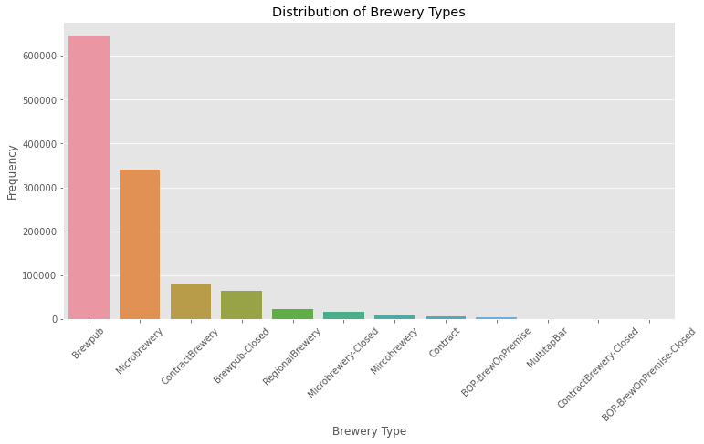
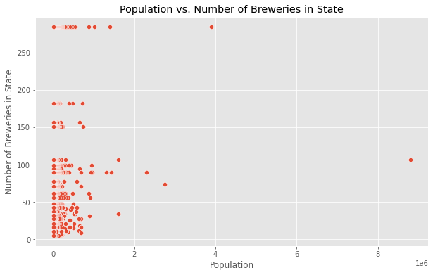
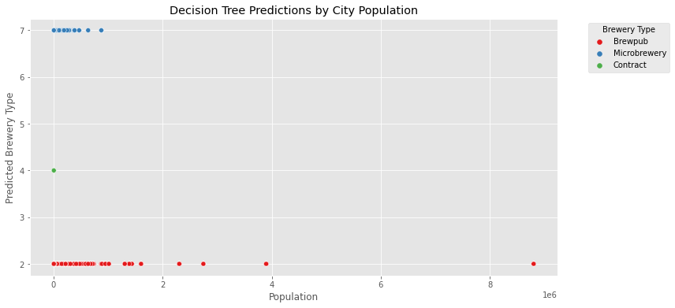
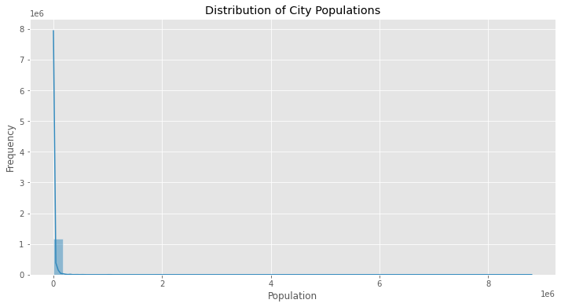
Visuals

Slide 8
Recommendations
Focus Regions: Concentrate on the Mountain West and Southeast regions for expansion due to diverse markets and untapped potential.
Urban Expansion: Target populous cities with fewer breweries like Omaha and Nashville for market penetration.
Growing Cities Strategy: Explore markets in growing cities known for specific attributes like Frederick and Norman.
Digital Engagement: Emphasize online presence and digital strategies for market reach and competitiveness.

Slide 9
Conclusion
Based on the results from the analyses, here is a conclusion that summarizes the key findings:
Regression Model (Predicting Number of Breweries):
The regression model, aimed at predicting the number of breweries based on city population, yielded a Mean Squared Error (MSE) of 5636.61 and an R-squared (R²) of 0.0213.
The high MSE indicates a significant average error in the model's predictions. The low R² value suggests that only a small portion (about 2.13%) of the variance in the number of breweries is explained by the population size.
This implies that while there is some relationship between population size and the number of breweries, other factors not captured in the model likely play a significant role.
Classification Model (Predicting Brewery Type):
The classification model, used to predict the type of brewery based on city population, achieved an accuracy of approximately 54.04%.
The classification report reveals varying performance across different brewery types. The model is particularly effective in identifying 'Brewpubs' (precision: 0.54, recall: 0.98) but struggles with other types like 'Microbrewery' and 'Brewpub-Closed,' where both precision and recall are low.
This indicates that while the model can predict certain brewery types reasonably well, it is less effective for others, likely due to imbalanced data or the need for additional predictive features.
Feature Importance in Classification Model:
The feature importance score of [1.] from the Random Forest Classifier indicates that the population is the sole feature used and is given full importance.
This suggests that population size is a key factor in the model's predictions. However, the reliance on a single feature highlights the need for a more diverse set of variables to improve the model's accuracy and comprehensiveness.
Overall Insights: The analyses suggest that city population size does have an influence on both the number of breweries and their types. However, the limited predictive power and performance variations across models indicate that additional factors, possibly including economic and other demographic variables, would be necessary to enhance the models' accuracy and provide a more holistic understanding of the brewery landscape in different cities.

